Slide 1
Linear
Regression
Data : JFK Airport data (source : IEEE Academic paper)

Slide 2

Objective
Build a machine learning model and established linear relations between feature and target variable of Taxi out delay time
ML Model
Linear Regression model
Lasso
Gradient Descent
Ridge
Random Forest model

Slide 3
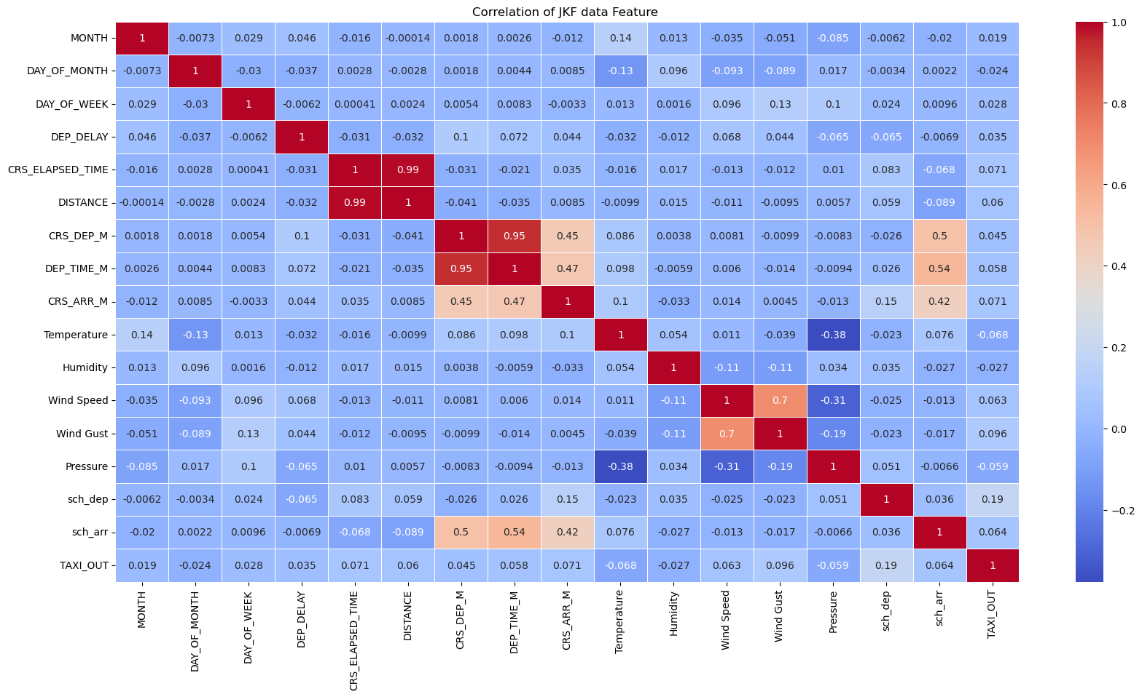

Slide 4
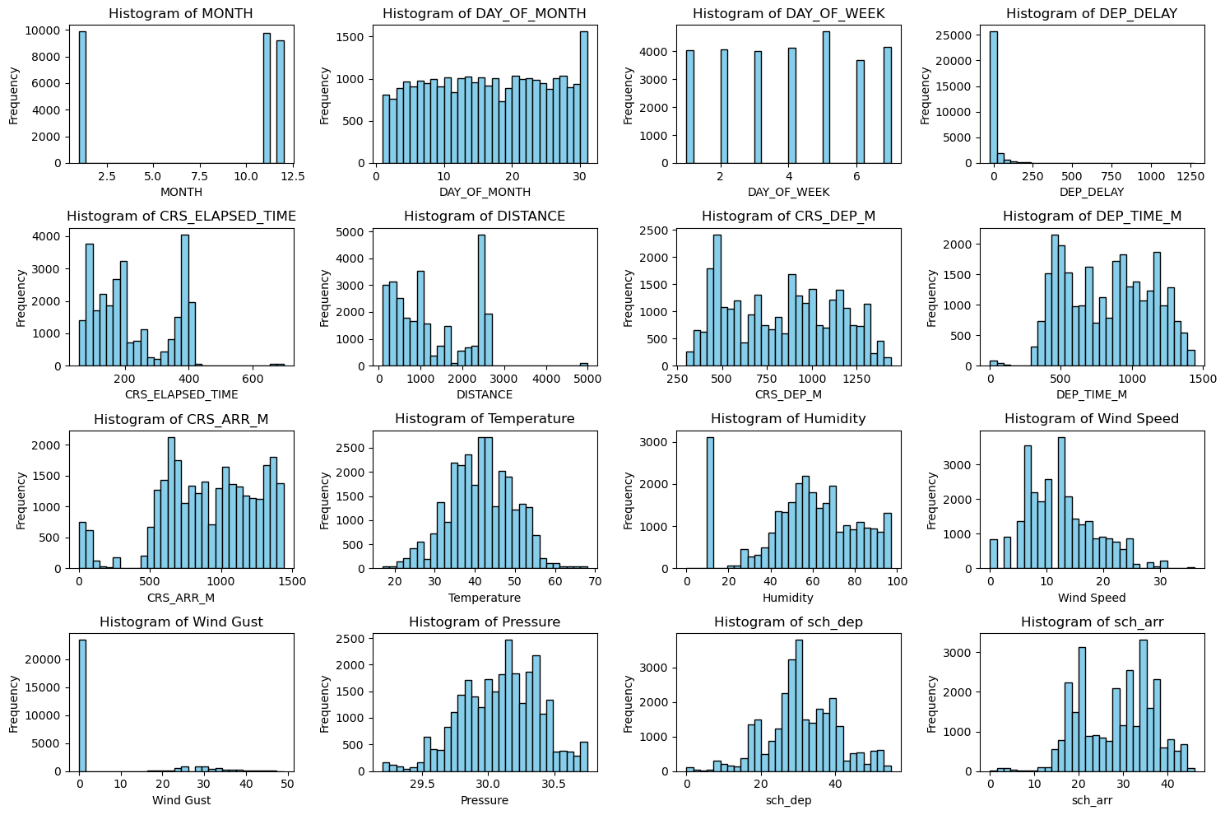

Slide 5
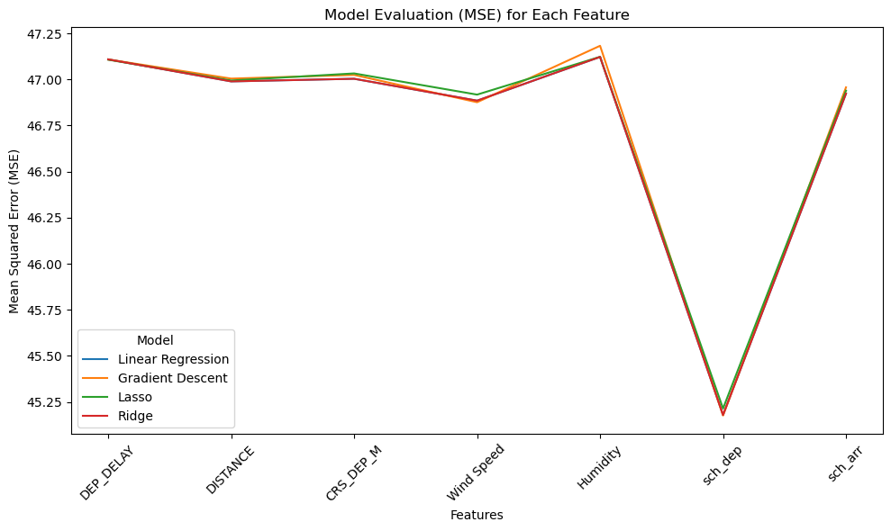

Slide 6
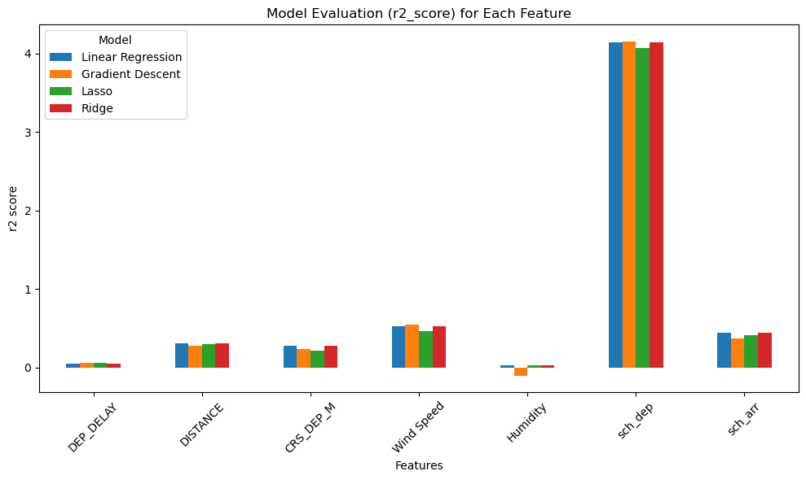

Slide 7
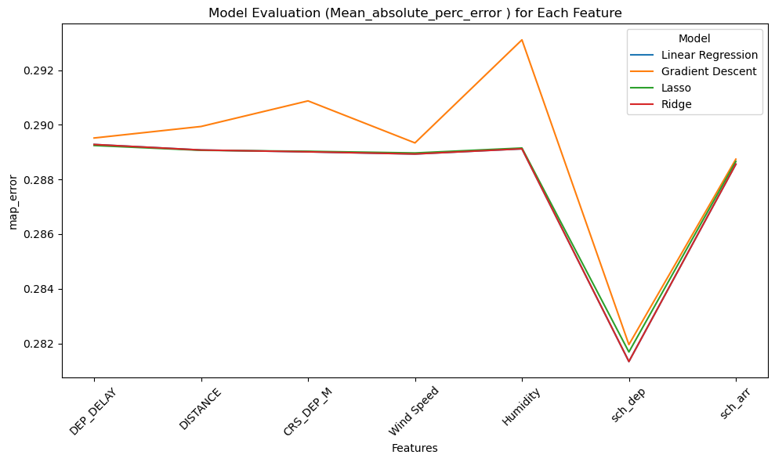

Slide 8
RENDOM FOREST MODEL
R2 SCORE :
0.422
MEAN SQUAR ERROR
66.41
ROOT MEAN SQUAR ERROR
8.14
ACCURACY SCORE
0.07

Slide 9
Conclusion
In conclusion, this EDA has provided valuable insights into our target variable, taxi-out times, using different features from the dataset. While our primary goal was to identify a linear relationship between the target and various features, the linear model did not perform as expected. This suggests that additional or higher-quality data may be needed to improve model accuracy and better capture the factors influencing taxi-out time.

Slide 10
Question & Answer
Thank You

